Slide 1




NEXT GEN EMPLOYABILITY PROGRAM
Creating a future-ready workforce
Team Members
College Name
Student Name :v.sangeetha
Student ID :912421104038
Shanmuganathan engineering college

Slide 2

CAPSTONE PROJECT SHOWCASE
Project Title
Voting Application using Django sangeetha(4038,SEC)
Abstract | Problem Statement | Project Overview | Proposed Solution | Technology Used | Modelling & Results | Conclusion

Slide 3
Abstract : Django Online Voting System
We will create a pollster (voting system) web application using Django. This application will conduct a series of questions along with many choices. A user will be allowed to give voting for that question by selecting a choice. Based on the answer the total votes will be calculated and it will be displayed to the user. Users can also check the result of the total votes for specific questions on the website directly. We will also build the admin part of this project. Admin user will be allowed to add questions and manage questions in the application.
Source :

Slide 4
Problem Statement
The primary objective of the Python Django online voting system is
to provide a convenient and efficient method for eligible voters to cast their votes using the internet.
Voters can access the voting process through a secure website or a dedicated voting application.
Aim to build a web application that facilitate voting on various questions . User can select their preferred choice for each question and t6he system will calculate and display the total votes
Source :

Slide 5
Proposed Solution
.
Project Setup:
Start a new Django project: django-admin startproject voting_app.
Create a new Django app for the voting functionality: python manage.py startapp vote.
Models:
Define models for your voting system. For example, you might have a Poll model to represent each poll and a Choice model to represent the choices for each poll.
Source :

Slide 6


Technology Used
Front-end
Back-end
Source :

Slide 7
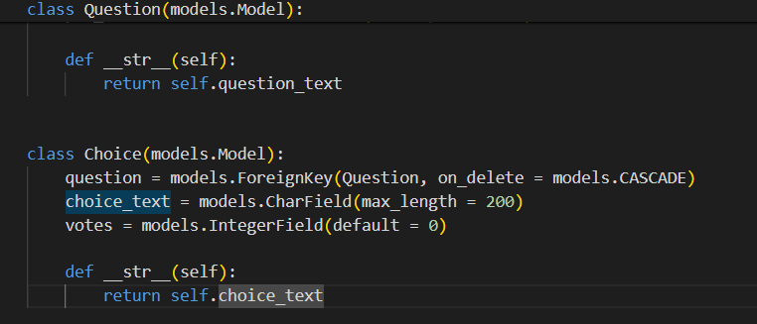
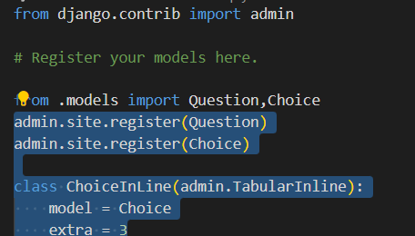
Models.py
Admin.py
Source :

Slide 8
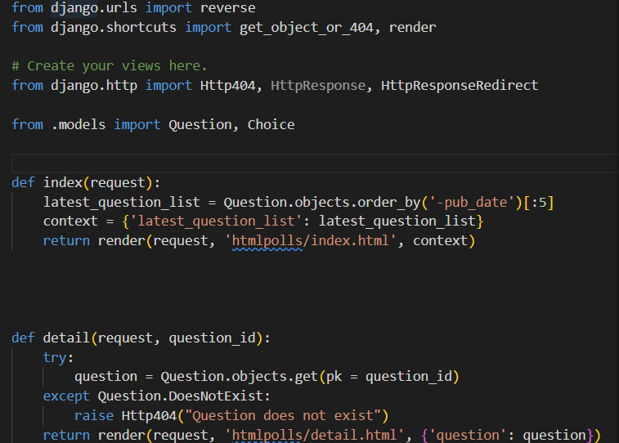
Views.py
Create view to handle displaying polls and submitting
votes
Source :

Slide 9
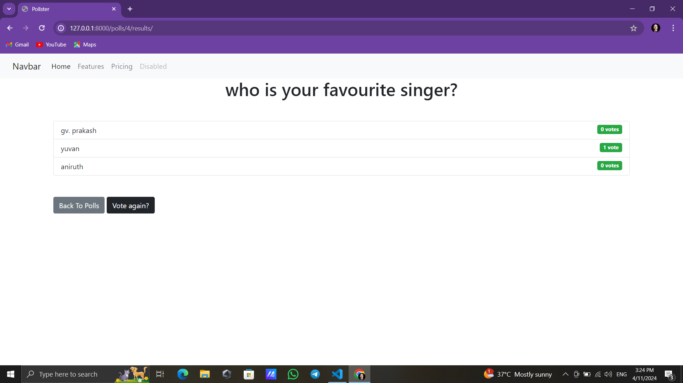
Modelling & Results
Source :

Slide 10
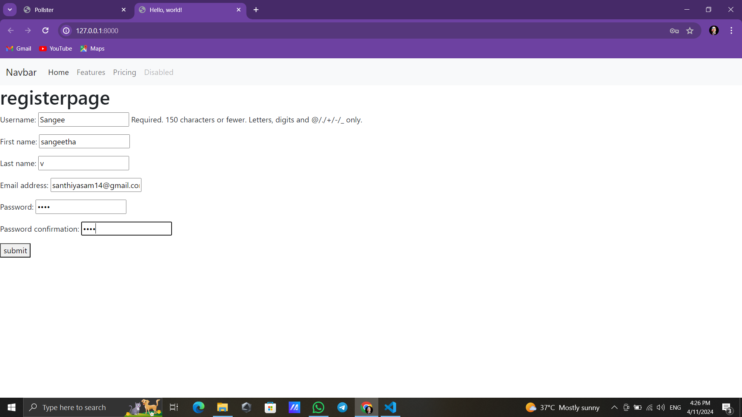
Register page

Slide 11
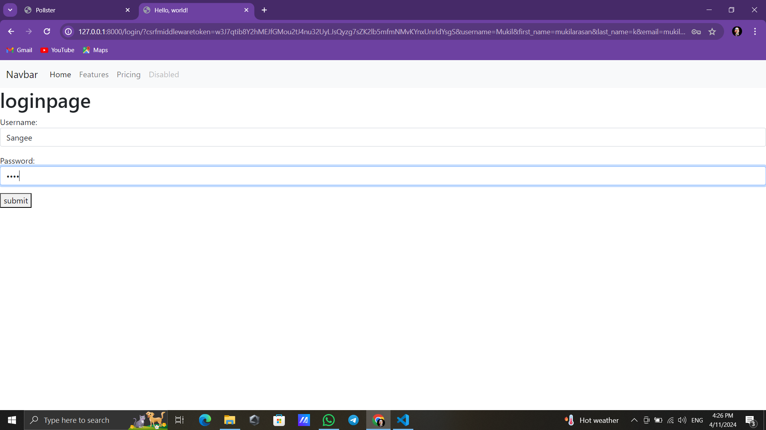
Login page

Slide 12
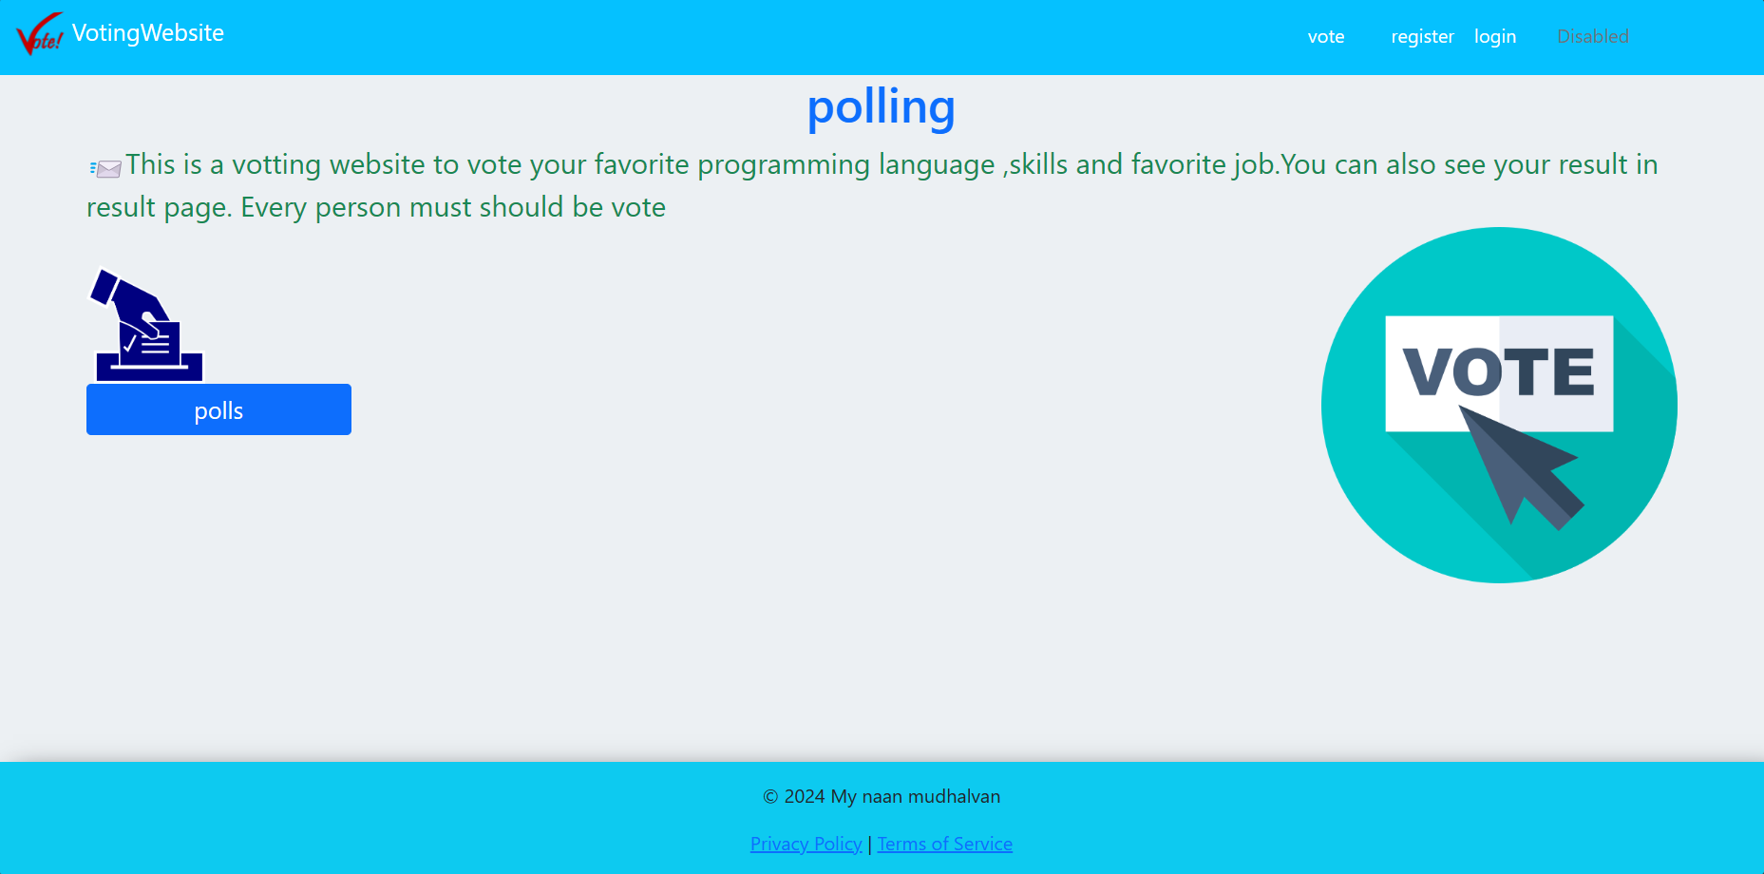
Home-page

Slide 13
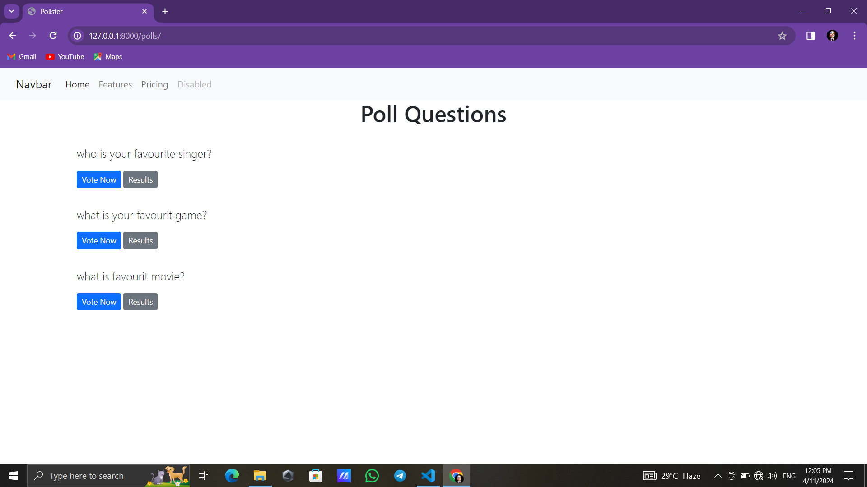
Question-page

Slide 14
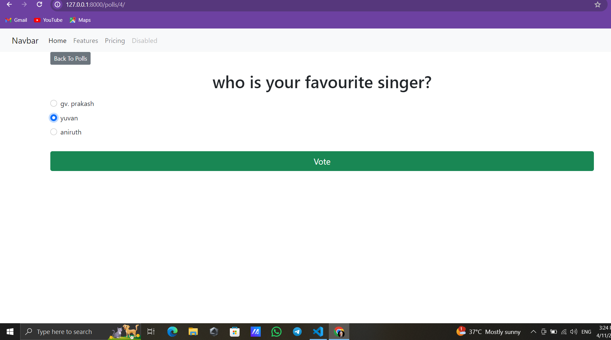
Question-page

Slide 16


Slide 17


Slide 18
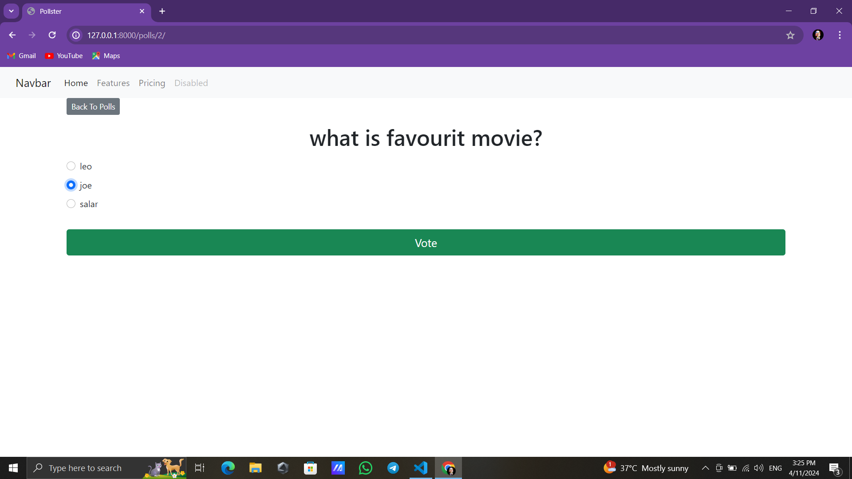

Slide 19
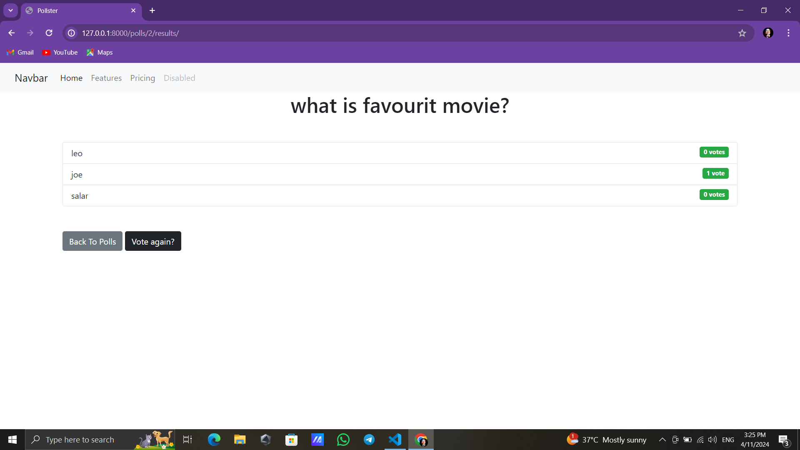

Slide 20
Result-page

Slide 21
Future Enhancements:
User Authentication:
Implement user authentication to allow only registered users to vote.
Associate each vote with a user to prevent duplicate voting.
Multiple Choice Options:
Allow users to select multiple choices for a single poll.
Implement validation to ensure users do not exceed the allowed number of choices.
Real-Time Updates:
Use WebSockets or server-sent events to provide real-time updates of poll results without requiring page refreshes.
Improved UI/UX:
Enhance the user interface with modern design principles and responsive layouts.
Implement client-side validation for a smoother user experience. polls.

Slide 22
Conclusion
In conclusion, the Django polling application offers a comprehensive solution for conducting polls with various advanced features to enhance user experience and functionality. By leveraging Django's powerful framework, along with modern frontend technologies and third-party services, we've created a robust platform for managing polls and engaging users.
Source :

Slide 23
Thank You!
Notes:
Thank You !!

